Slide 1


Prescribing APP
Doctor – Patient Assistance to understand drug-drug interaction
Data Engineering Course Project December 2021

Slide 2
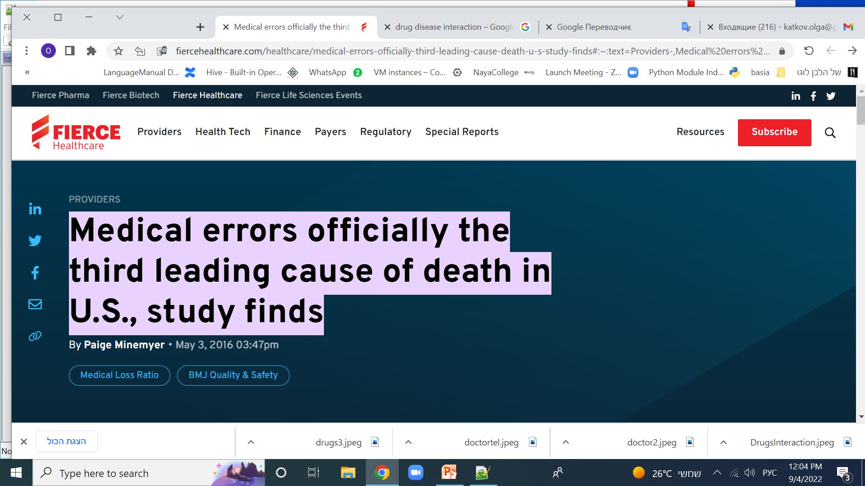
Background
What Doctors really needs?
Background
What We Do
Medical errors officially the third leading cause of death in U.S.
study finds a large proportion of these deaths are due to improper selection of drugs for chronic patients and with a wide range of constantly taken drugs
They wish someone could have directed them to:
Selection of the optimal drug for a patient with a complex set of diagnoses
Building a Doctor – Patient Assistance to understand drug-drug interaction
  …
architecture
NiFi
ERD
Spark
HDFS
Reports

Slide 3

What We Do
Background
Background
In this project developed automatic checking of a new drug recommended by a doctor for a patient for interaction with constantly taken drugs.
Interaction can be both positive (synergy) and negative, harming the patient.
To warn the doctor about the possible negative effects of the new drug is the goal of this project.
    Drug Antagonism
    Drug Interaction
    Drug Synergism
To do that, I used big data tools to be able to analyze information in real time.
I prepare the Pipeline that will be used for real-time analytics, created with Big Data Technologies Such as:
  Kafka: Producer, Consumer
  Mango db json document store
  Hadoop: Hue, Hive ,MySQL DB
  Software language: Python
What We Do
What We Do
architecture
architecture
NiFi
NiFi
ERD
ERD
Spark
Spark
HDFS
HDFS
Reports
Reports

Slide 4
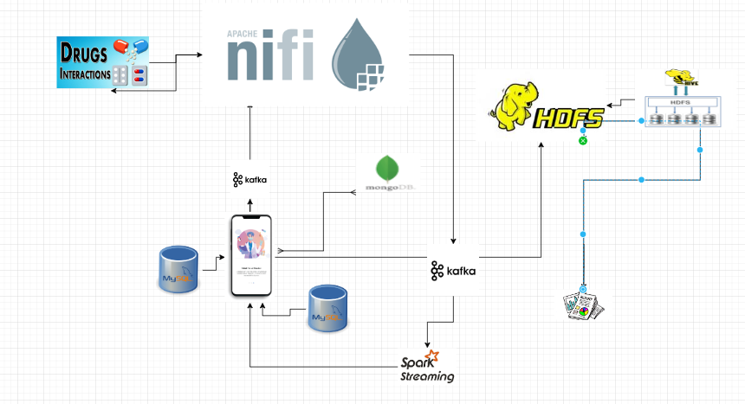
Architecture Overview:
Background
Background
Background
What We Do
What We Do
What We Do
architecture
architecture
architecture
NiFi
NiFi
ERD
ERD
Spark
Spark
HDFS
HDFS
Reports
Reports

Slide 5
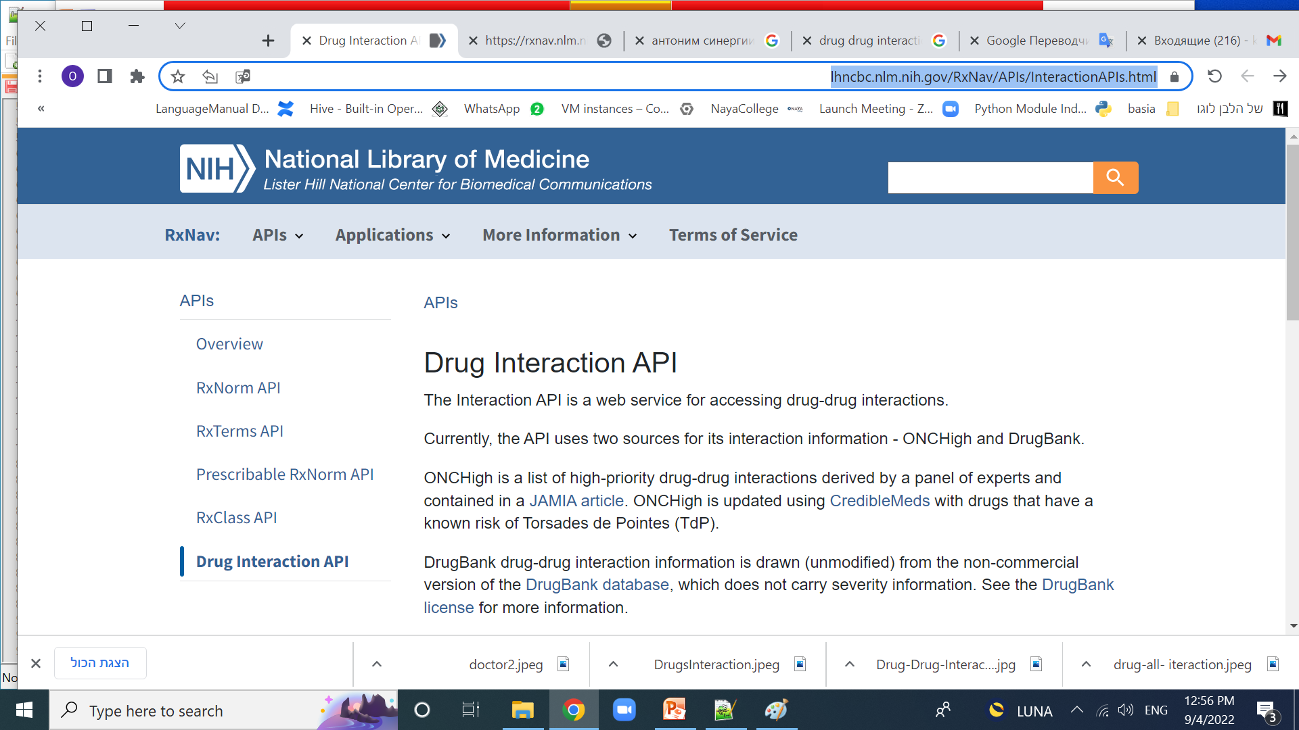
Architecture Overview:
Background
Background
Background
What We Do
What We Do
What We Do
architecture
architecture
architecture
NiFi
NiFi
ERD
ERD
Spark
Spark
HDFS
HDFS
Reports
Reports

Slide 6
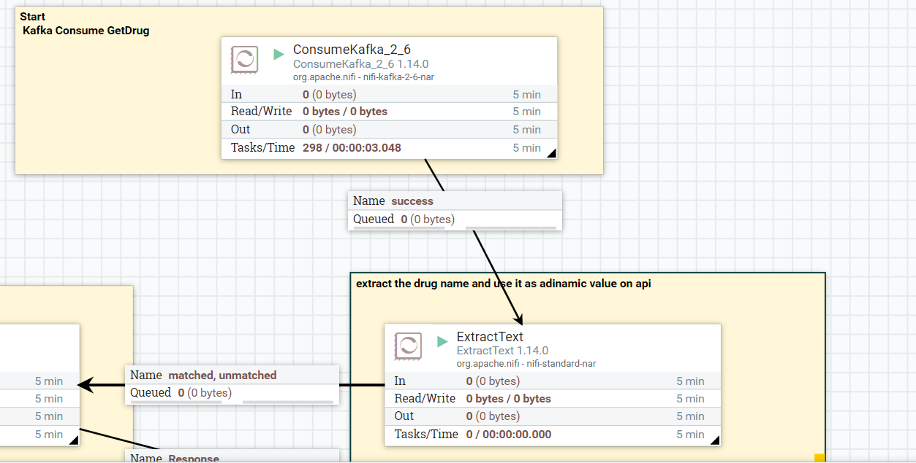
Data streaming With in nifi
Background
Background
Background
What We Do
What We Do
What We Do
architecture
architecture
architecture
NiFi
NiFi
ERD
ERD
Spark
Spark
ConsumeKafka_2_6 1.14.0:
receive getDrug requests from clients with specific drug name as parameter
ExtractText:
extract the drug name and use it as a parameter on api call, saved as nifi process attribute
HDFS
HDFS
Reports
Reports

Slide 7
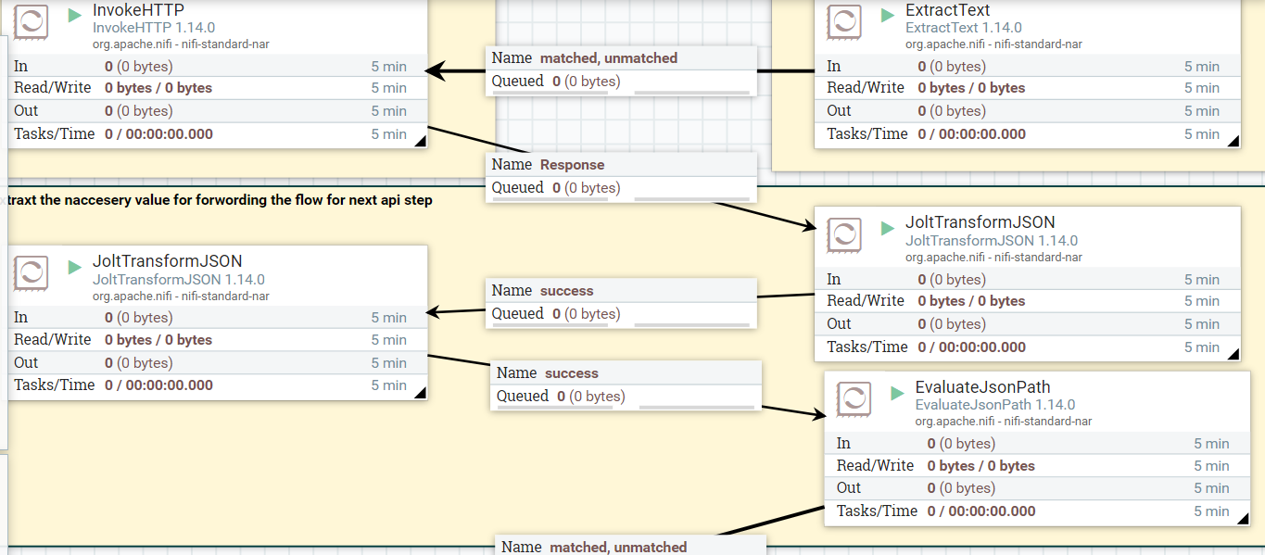
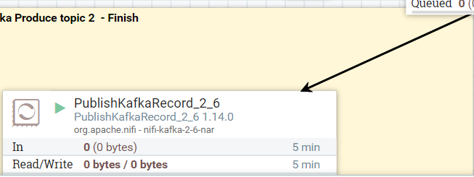
Data streaming With in nifi
Background
Background
Background
What We Do
What We Do
What We Do
architecture
architecture
architecture
NiFi
NiFi
ERD
ERD
Spark
Spark
HDFS
HDFS
Build 1st API request and get drugId from drug name, build 2d Api request from id received
2d api call for get drug interaction, Result data transformation, kafka producer send result
Reports
Reports

Slide 8
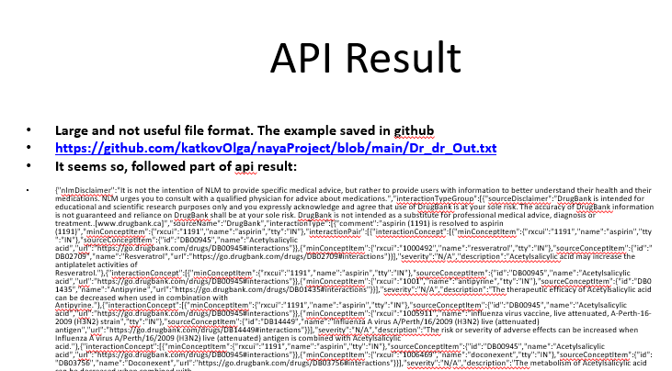
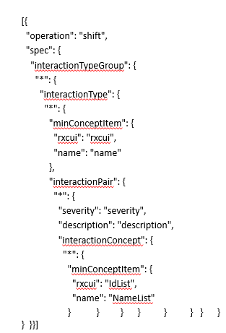
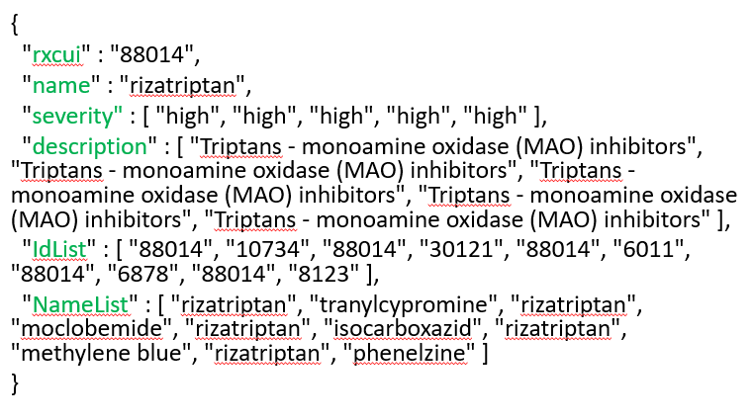
Data streaming With in nifi
Background
Background
Background
What We Do
What We Do
What We Do
architecture
architecture
architecture
NiFi
NiFi
ERD
ERD
Spark
Spark
HDFS
HDFS
Reports
Reports

Slide 9
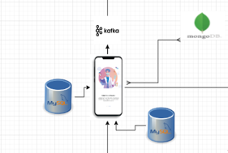
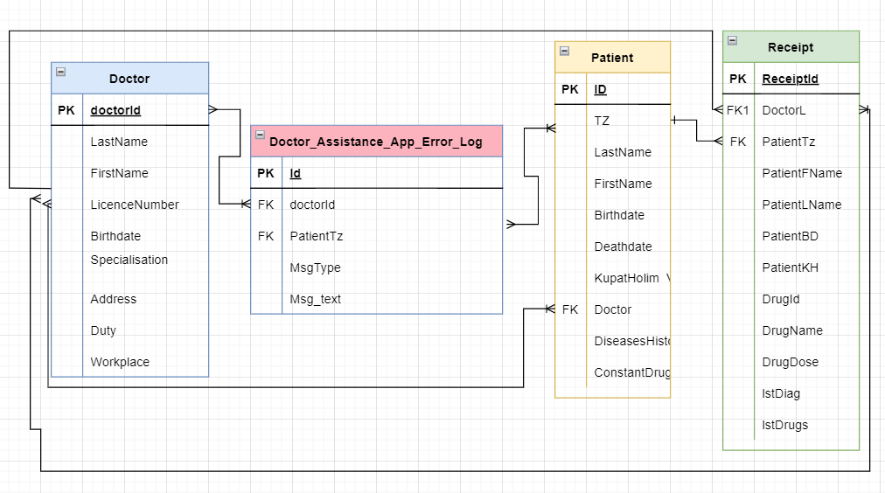
ERD of Doctor DB
Background
Background
Background
What We Do
What We Do
What We Do
architecture
architecture
architecture
NiFi
NiFi
ERD
ERD
Spark
Spark
HDFS
HDFS
Reports
Reports

Slide 10
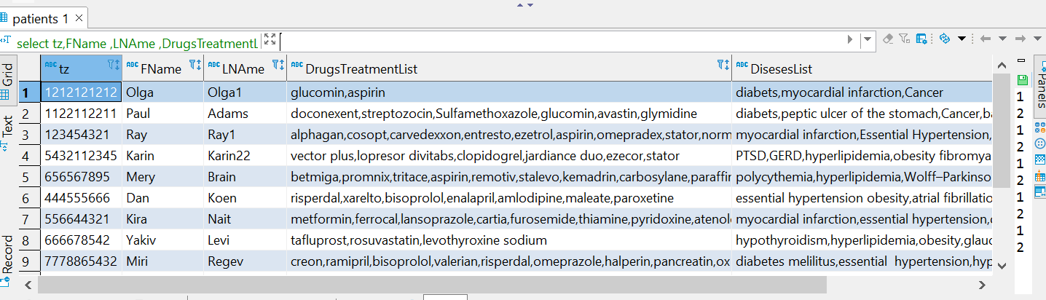
ERD of Doctor DB
Background
Background
Background
What We Do
What We Do
What We Do
architecture
architecture
architecture
NiFi
NiFi
ERD
ERD
Spark
use doctors;
select tz,FName ,LNAme ,DrugsTreatmentList ,DisesesList from patients;
Spark
HDFS
HDFS
Reports
Reports

Slide 11
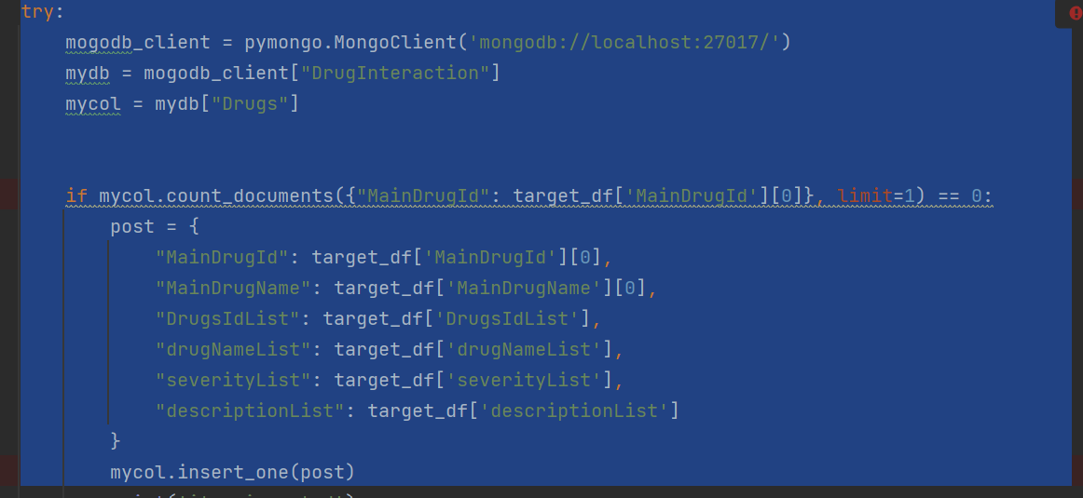
ERD of Doctor DB
Background
Background
Background
What We Do
What We Do
What We Do
architecture
architecture
architecture
NiFi
NiFi
ERD
ERD
Spark
Spark
HDFS
HDFS
Reports
Reports

Slide 12
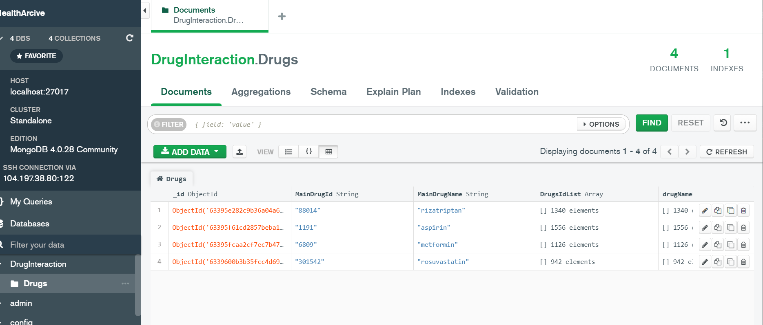
ERD of Doctor DB
Background
Background
Background
What We Do
What We Do
What We Do
architecture
architecture
architecture
Mango db –alternative further data source
NiFi
NiFi
ERD
ERD
Spark
Spark
HDFS
HDFS
Reports
Reports

Slide 13
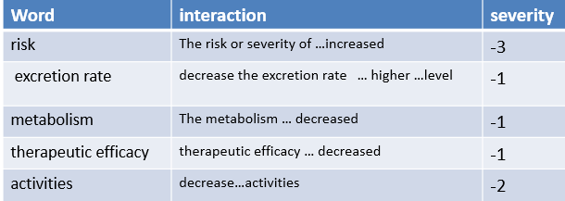
Background
Background
Background
Spark
Lexical analysis & data transformation
What We Do
What We Do
What We Do
architecture
architecture
architecture
In this api we have not direct interaction & severity definition and need implement lexical analysis to understand the result.
NiFi
NiFi
ERD
ERD
Spark
Spark
HDFS
HDFS
Reports
Reports

Slide 14
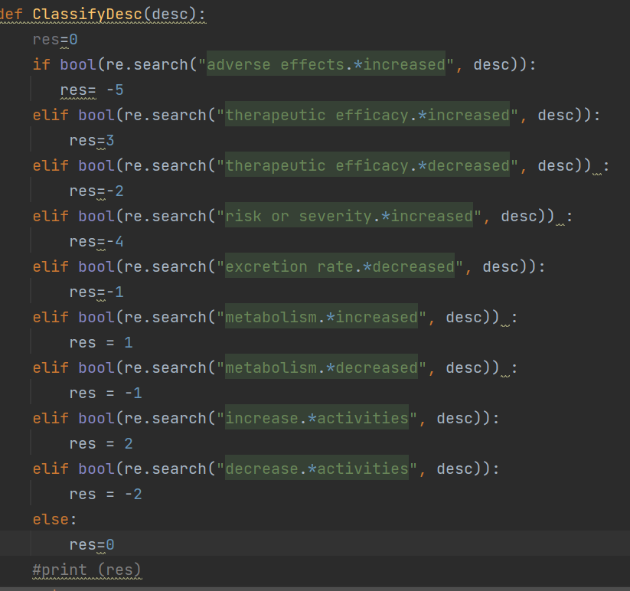
Sentimental analysis by regular expressions use
Background
Background
Background
Spark
Lexical analysis & data transformation
What We Do
What We Do
What We Do
architecture
architecture
architecture
NiFi
NiFi
ERD
ERD
Spark
Spark
HDFS
HDFS
Reports
Reports

Slide 15
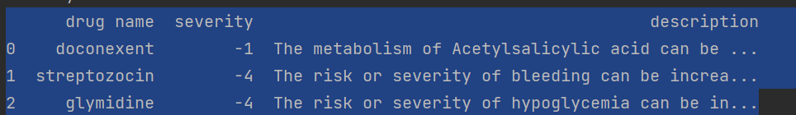
Sentimental analysis by regular expressions use
Background
Background
Background
Spark
Lexical analysis & data transformation
What We Do
What We Do
What We Do
architecture
architecture
architecture
NiFi
NiFi
ERD
ERD
Spark
Spark
Result dataframe for doctor
HDFS
HDFS
Reports
Reports

Slide 16
Background
Background
Background
HDFS
archive file structure
What We Do
What We Do
What We Do
architecture
architecture
architecture
Parquet format Json file
CREATE EXTERNAL TABLE IF NOT EXISTS receiptarchive.ReceiptHistory(DoctorLicense String, PatientTZ String, PatientFirstName String,ConflictSExists Boolean, PatientLastName String, KupatHolim String, PtienBirthdate String, DrugName String, DrugId String, DrugDose String, dateCreated String, PatientDiseasesLqist String, PatientTreatmentsList String,
drugDrugInteractionJson String)
stored as Parquet
Location '/user/hive/warehouse/receiptarchive.db';
NiFi
NiFi
ERD
ERD
Spark
Spark
HDFS
HDFS
Reports
Reports

Slide 17
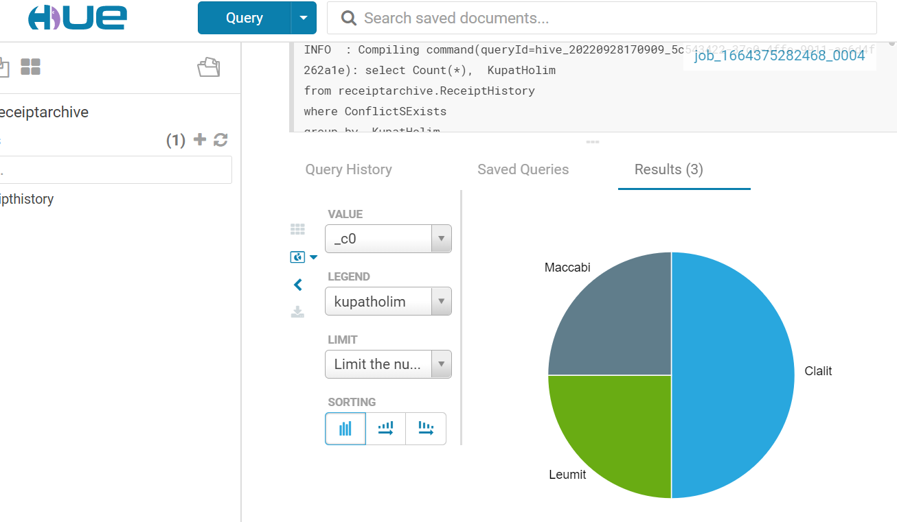
Report by Kupat Holim
Background
Background
What We Do
What We Do
architecture
architecture
NiFi
NiFi
ERD
ERD
Spark
Spark
HDFS
HDFS
Reports
Reports

Slide 18
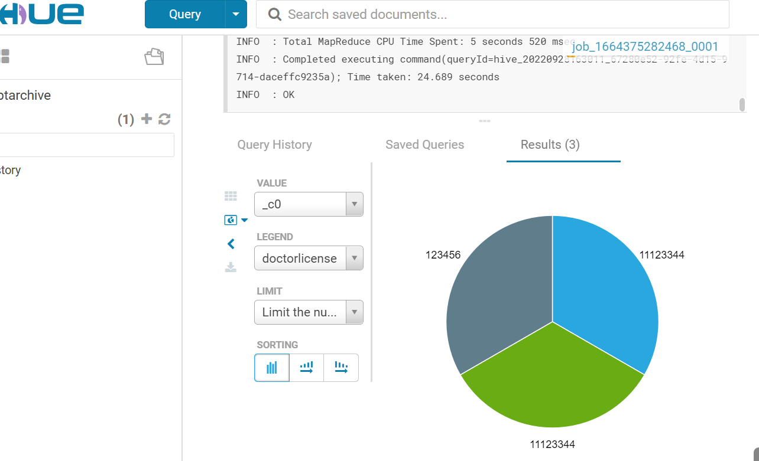
Report by Doctor License
Background
Background
What We Do
What We Do
architecture
architecture
NiFi
NiFi
ERD
ERD
Spark
Spark
HDFS
HDFS
Reports
Reports

Slide 19
Thank You

